Slide 1
Where do Rights come from?
From men?
The Constitution?
Or
Something Else?

Slide 2
We hold these truths to be self-evident, that all men are created equal, that they are endowed by their Creator with certain unalienable Rights.
(Declaration of Independence)

Slide 3
Declaration of Independence
“That to secure these rights, Governments are instituted among Men, deriving their just powers from the consent of the governed, --That whenever any Form of Government becomes destructive of these ends, it is the Right of the People to alter or to abolish it, and to institute new Government, laying its foundation on such principles and organizing its powers in such form, as to them shall seem most likely to effect their Safety and Happiness.…. But when a long train of abuses and usurpations, pursuing invariably the same Object evinces a design to reduce them under absolute Despotism, it is their right, it is their duty, to throw off such Government, and to provide new Guards for their future security.”

Slide 4
ARTICLE II BILL OF RIGHTS
Colo. Const. Art. II, Section 1 (2013)
Section 1. Vestment of political power
All political power is vested in and derived from the people; all government, of right, originates from the people, is founded upon their will only, and is instituted solely for the good of the whole.
Colo. Const. Art. II, Section 2 (2013)
Section 2. PEOPLE MAY ALTER OR ABOLISH FORM OF GOVERNMENT - PROVISO
The people of this state have the sole and exclusive right of governing themselves, as a free, sovereign and independent state; and to alter and abolish their constitution and form of government whenever they may deem it necessary to their safety and happiness, provided, such change be not repugnant to the constitution of the United States.

Slide 5
Supremacy Clause
Article VI, section 2 of the U. S. Constitution : This Constitution, and the Laws of the United States which shall be made in pursuance thereof; and all treaties made, or which shall be made, under the authority of the United States, shall be the supreme law of the land; and the judges in every state shall be bound thereby, any thing in the Constitution or laws of any state to the contrary notwithstanding."

Slide 6
Congress shall make no law respecting an establishment of religion, or prohibiting the free exercise thereof, or abridging the freedom of speech, or of the press, or the right of the people peaceably to assemble, and to petition the Government of a redress of grievances.

Slide 7
"Any law that is repugnant to the constitution is null and void of law." Marbury v Madison, 5 US 137
1803

Slide 8
TITLE 30. GOVERNMENT - COUNTY
COUNTY POWERS AND FUNCTIONS
ARTICLE 11.COUNTY POWERS AND FUNCTIONS
PART 1. GENERAL PROVISIONS
C.R.S. 30-11-103.5 (2013)
30-11-103.5. County petitions and referred measures
The procedures for placing an issue or question on the ballot by a petition of the electors of a county that is pursuant to statute or the state constitution or that a board of county commissioners may refer to a vote of the electors pursuant to statute or the state constitution shall, to the extent no such procedures are prescribed by statute, charter, or the state constitution, follow as nearly as practicable the procedures for municipal initiatives and referred measures under part 1 of article 11 of title 31, C.R.S. The county clerk and recorder shall resolve any questions about the applicability of the procedures in part 1 of article 11 of title 31, C.R.S.

Slide 9
TITLE 31. GOVERNMENT - MUNICIPAL
MUNICIPAL ELECTIONS
ARTICLE 11. MUNICIPAL INITIATIVES, REFERENDA, AND REFERRED MEASURES
C.R.S. 31-11-104 (2013)
31-11-104. Ordinances - initiative - conflicting measures
(1) Any proposed ordinance may be submitted to the legislative body of any municipality by filing written notice of the proposed ordinance with the clerk and, within one hundred eighty days after approval of the petition pursuant to section 31-11-106 (1), by filing a petition signed by at least five percent of the registered electors of the city or town on the date of such notice. The proposed ordinance may be adopted without alteration by the legislative body within twenty days following the final determination of petition sufficiency. If vetoed by the mayor, the proposed ordinance may be passed over the mayor's veto within ten days after the veto. If the proposed ordinance is not adopted by the legislative body, the legislative body shall forthwith publish the proposed ordinance as other ordinances are published and shall refer the proposed ordinance, in the form petitioned for, to the registered electors of the municipality at a regular or special election held not less than sixty days and not more that one hundred fifty days after the final determination of petition sufficiency, unless otherwise required by the state constitution. The ordinance shall not take effect unless a majority of the registered electors voting on the measure at the election vote in favor of the measure.

Slide 10
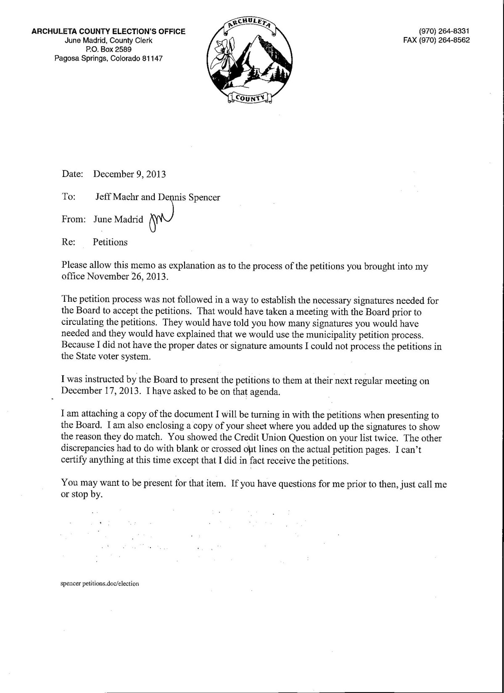

Slide 11
The initiative provisions are expressly declared to be self-executing, and, as such, only legislation which will further the purpose of the constitutional provision or facilitate its operation, is permitted. Colo. Project-Common Cause v. Anderson, 178 Colo. 1, 495 P.2d 220 (1972).

Slide 12
PHRASE "THAT IT SHALL BE IN ALL RESPECTS SELF-EXECUTING" MERELY MEANS that the power of initiative and referendum rests with the people whether or not the general assembly implements the power. It does not prevent the general assembly from enacting legislation which will strengthen that power. In re Interrogatories Propounded by Senate Concerning House Bill 1078, 189 Colo. 1, 536 P.2d 308 (1975).

Slide 13
CONSTITUTION OF THE STATE OF COLORADO
ARTICLE V LEGISLATIVE DEPARTMENT
Colo. Const. Art. V, Section 25 (2013)
Section 25. SPECIAL LEGISLATION PROHIBITED
The general assembly shall not pass local or special laws in any of the following enumerated cases, that is to say; for granting divorces; laying out, opening, altering or working roads or highways; vacating roads, town plats, streets, alleys and public grounds; locating or changing county seats; regulating county or township affairs; regulating the practice in courts of justice; regulating the jurisdiction and duties of police magistrates; changing the rules of evidence in any trial or inquiry; providing for changes of venue in civil or criminal cases; declaring any person of age; for limitation of civil actions or giving effect to informal or invalid deeds; summoning or impaneling grand or petit juries; providing for the management of common schools; regulating the rate of interest on money; the opening or conducting of any election, or designating the place of voting; the sale or mortgage of real estate belonging to minors or others under disability; the protection of game or fish; chartering or licensing ferries or toll bridges; remitting fines, penalties or forfeitures; creating, increasing or decreasing fees, percentage or allowances of public officers; changing the law of descent; granting to any corporation, association or individual the right to lay down railroad tracks; granting to any corporation, association or individual any special or exclusive privilege, immunity or franchise whatever. In all other cases, where a general law can be made applicable no special law shall be enacted.

Slide 14
Petition County Ordinance
All political power is vested in and derived from the people; all government, of right, originates from the people, is founded upon their will only.
The people of Archuleta County have the sole and exclusive right of governing themselves, as a free, sovereign and independent People endowed by their creator with certain unalienable rights; and they may alter and abolish their form of government whenever they may deem it necessary to their safety and happiness, provided, such change be not repugnant to the constitution of the United States.
Any proposed ordinance may be submitted to the legislative body of Archuleta County by filing written notice of the proposed ordinance with the County Clerk and, within one hundred eighty days after approval of the petition pursuant to section 31-11-106 (1) of the Colorado Revised Statutes, by filing a petition signed by at least five percent of the registered electors based on the number of electors that voted in the last general election of the county on the date of such notice as noted by the County Clerk. When petitions are submitted, the County Clerk has 30 days to count the petitions and verify the sufficiency of the petitions and may use the help of volunteers to accomplish this task. The proposed county ordinance may be adopted without alteration by the legislative body within twenty days following the final determination of petition sufficiency with a 2/3 majority. If the proposed ordinance is not adopted by the legislative body, the legislative body shall forthwith publish the proposed ordinance as other ordinances are published and shall refer the proposed ordinance, in the form petitioned for, to the registered electors of the County at a regular or special election held not less than sixty days and not more than one hundred fifty days after the final determination of petition sufficiency, unless otherwise required by the state constitution. The ordinance shall not take effect unless a majority of the registered electors voting on the measure at the election vote in favor of the measure.
Alternative ordinances may be submitted at the same election, and, if two or more conflicting measures are approved by the people, the one that receives the greatest number of affirmative votes shall be adopted in all particulars as to which there is a conflict.
Initiated provisions shall be liberally construed in order to effectuate their purpose, to facilitate and not to hamper the exercise by the electors of rights granted thereby.
The County initiatives are not to be narrowly construed, but those who have been granted authority which would nullify referendum should be strictly construed.
Right of initiative pertains to any measure, whether constitutional or legislative, and, it encompasses legislation of every character.
The initiative provisions are expressly declared to be self-executing, and rest with the people whether or not the general assembly implements the power. Only legislation that furthers and strengthens the initiative powers are permitted.
All ballots are to be paper ballots and hand counted by volunteer electors to reduce the cost of an election.

Slide 15
● This section, as well as the statutes which implement it, must be liberally construed so as not to unduly limit or curtail the exercise of the initiative and referendum rights constitutionally reserved to the people. Colo. Project-Common Cause v. Anderson, 178 Colo. 1, 495 P.2d 220 (1972); Billings v. Buchanan, 192 Colo. 32, 555 P.2d 176 (1976).
● Initiated provisions shall be liberally construed in order to effectuate their purpose, to facilitate and not to hamper the exercise by the electors of rights granted thereby. Yenter v. Baker, 126 Colo. 232, 248 P.2d 311 (1952).
● The terms of this article, being a reservation to the people, are not to be narrowly construed. Burks v. City of Lafayette, 142 Colo. 61, 349 P.2d 692 (1960).
● POWER OF INITIATIVE LIBERALLY CONSTRUED. The initiative power reserved by the people is to be liberally construed to allow the greatest possible exercise of this valuable right. City of Glendale v. Buchanan, 195 Colo. 267, 578 P.2d 221 (1978); Committee For Better Health Care v. Meyer, 830 P.2d 884 (Colo. 1992).

